Slide 1

Vulnerability vs. Exploit vs. Threat?
Vulnerability – A weakness in a system
Exploit – a means of using/exploiting a vulnerability
Threat – The risk of the above
A threat is any vulnerability that an be exploited
Risk – the potential for loss or damage when a threat exploits a vulnerability. (Financial, privacy, etc.)
https://www.bmc.com/blogs/security-vulnerability-vs-threat-vs-risk-whats-difference/

Slide 2
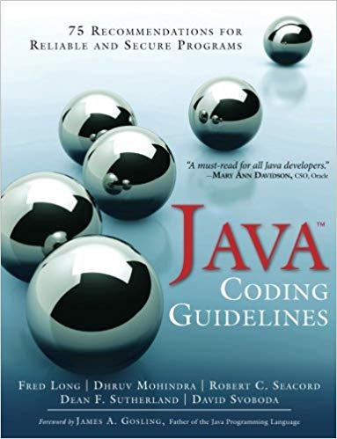
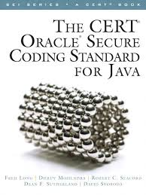
Vulnerability Protection?
How do we protect against vulnerabilities?
Develop secure software!
Top 10 Secure Coding Practices - CERT Secure Coding - Confluence
See link on Blackboard to this book
https://wiki.sei.cmu.edu/confluence/

Slide 3
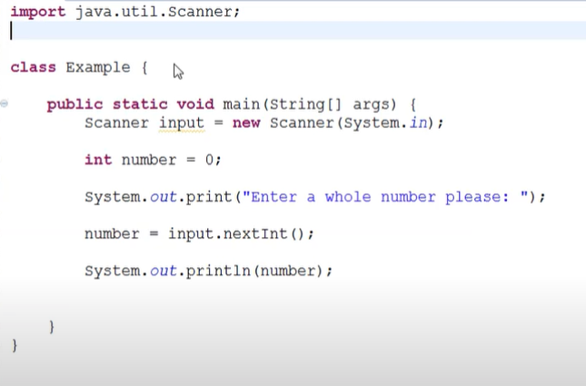
Input Validation
One of the basics of secure code, but What does that mean?

Slide 4
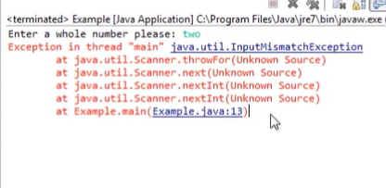
Input Validation
What happens if I type in the word ‘two’ ??
It gives me an error. Why?
What should I do?

Slide 5
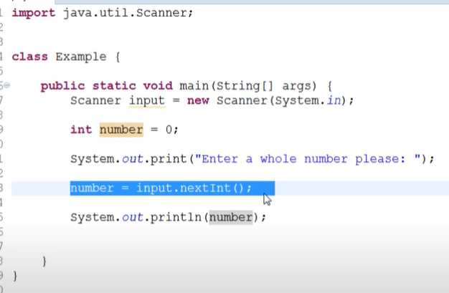
Validate the Input
The code will try and assign anything to number

Slide 6
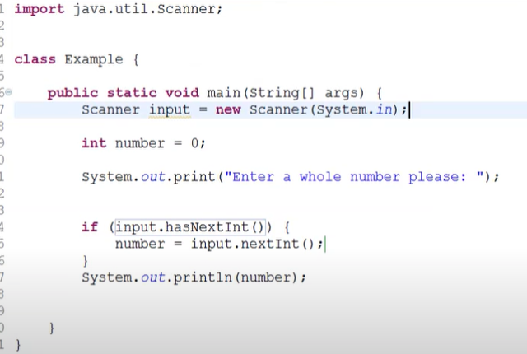
Validate the Input
First Check that the user has entered an Int
We need to check that we have a number!

Slide 7
Practical Exercise
Create a Program (use any language that you want) that will ask a user to their name and their age. Add code to make sure enter a string and an int.
You need to check that the values entered are not null
If either one of them in null, then we exit or add a loop to tell the user to try again
You need to check that the age is an int
If it’s not an int we exit or add a loop to tell the user to try again
You need to check that the name is a string
If it’s not an string we exit or add a loop to tell the user to try again

Slide 8
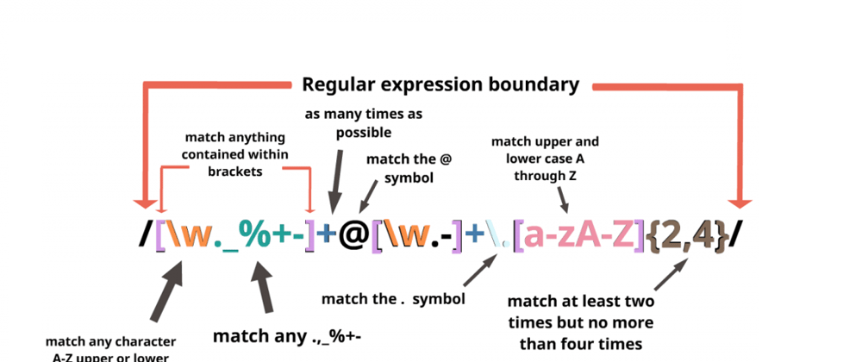
Introduction to Regular Expressions in Java
Extra Input Validation
A Practical Approach to Text Processing

Slide 9
What are Regular Expressions?
Purpose:
Simplify the process of searching for patterns in text.
Common Uses:
Data validation, parsing text, and string manipulation.

Slide 10
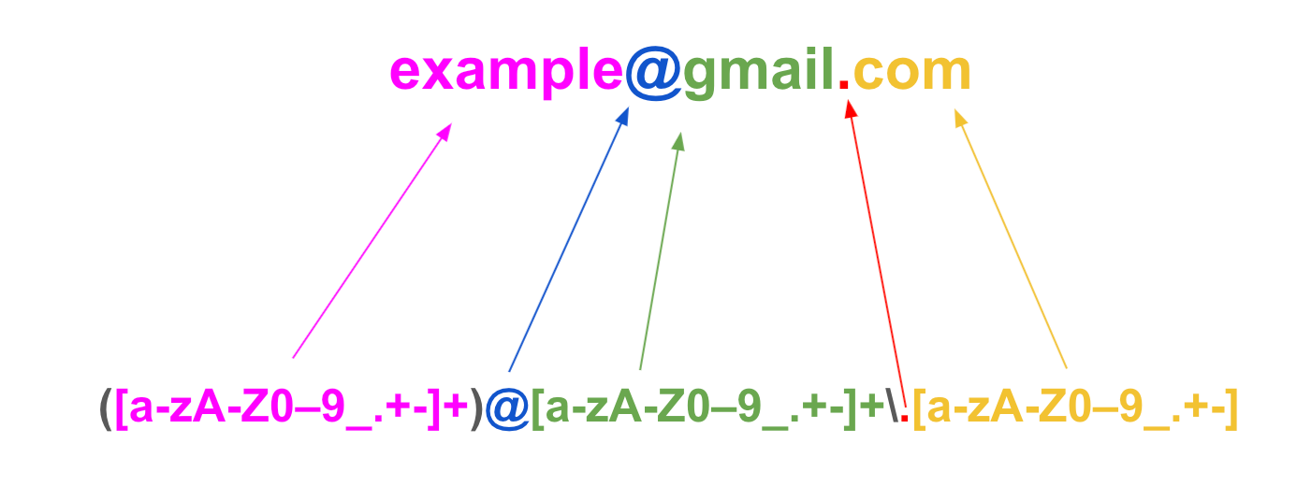
When to use??
Input Validation
{2,7}

Slide 11
Basic Syntax (varies for different languages)
Characters and Meta Characters
Characters: a-z A-Z 0-9
Example:
basic [abc] - matches a or b, or c
negation [^abc] - matches everything except a or b, or c
Range [a-c] - matches a or b, or c

Slide 12
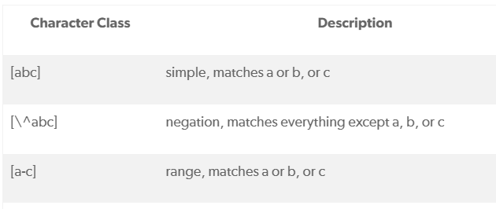
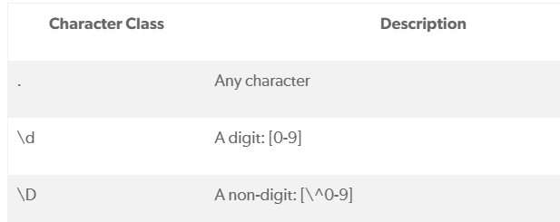
Basic Syntax (varies for different languages)

Slide 13
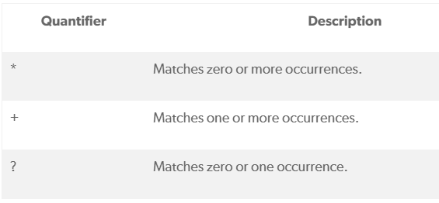
Java Regex Quantifiers

Slide 14
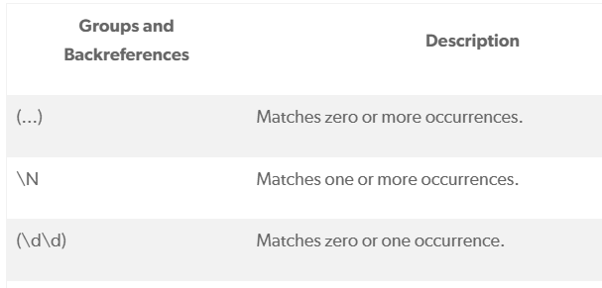
Java Regex Groups and Backreferences

Slide 15
Java's Regex Library
Pattern Class: Compile regular expressions into a pattern for use.
Matcher Class: Perform matching operations against a string.
matches() for whole string matching
find() for partial matches

Slide 16
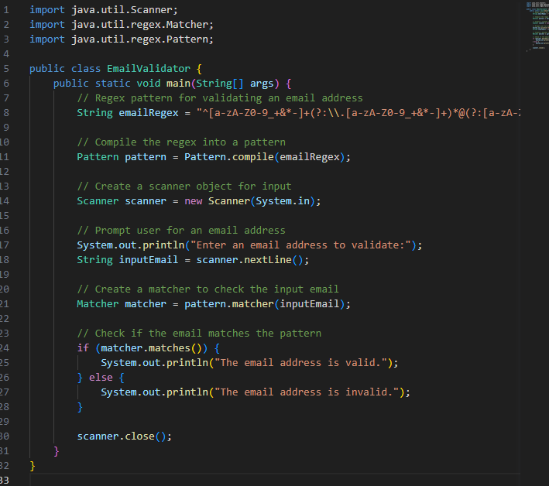
Java Code Example:
Email Validation
????

Slide 17
Practical Exercise
Create a Java Program that will ask a user to enter their email address and check it against a regular expression to validate it.
Create the Regular Expression (as a string)
String emailRegex = "^[a-z……
Compile the regex into a pattern
Pattern pattern = Pattern.compile(emailRegex);
Ask the user to enter an email address
Create a matcher to check the input email
Matcher matcher = pattern.matcher(inputEmail);
Check if the email matches the pattern

Slide 18
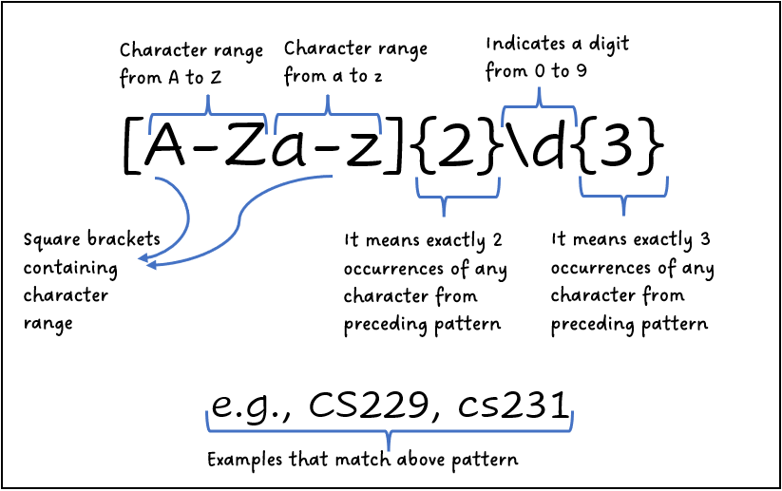
Python

Slide 19
More Regular Expressions
Validate the username : Make sure it is between 5 and 15 characters followed by a . followed by between 5 and 15 characters Eg: firstname.surname (maria.griffin)
Validate the password :
Ask for a password and make sure it is greater than 8 characters has upper and lower case, has at least one number and at least one symbol
Validate the email :
Make sure it conforms to characters(a-z) followed by @ followed by characters(a-z) followed by . followed by 2/3 characters… eg: email@email.com
You can use https://regexr.com to help you build up your RegEx.
Other sources :
https://regex101.com/
https://regex-generator.olafneumann.org/

